Slide 1


Slide 2


Slide 3


Slide 4

Notes:
Research shows that customers who experience positive interactions with your company on social media are almost three times more likely to recommend your brand. Neil Patel

Slide 5


Slide 6


Slide 7


Slide 8
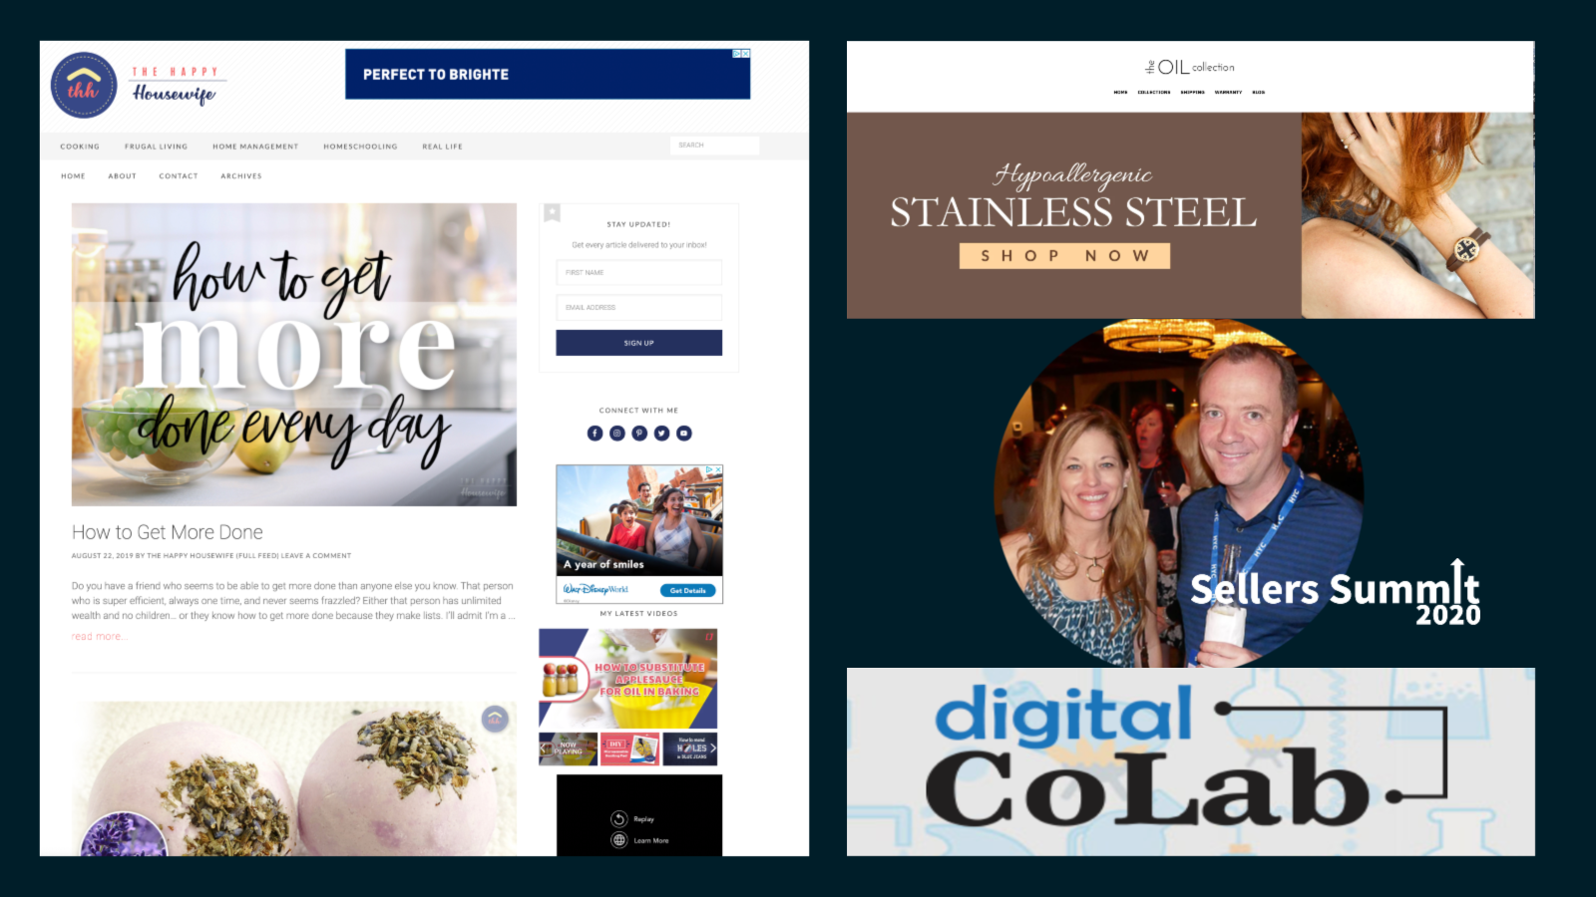

Slide 9

Notes:
What if you aren’t a great writer?

Slide 10


Slide 11
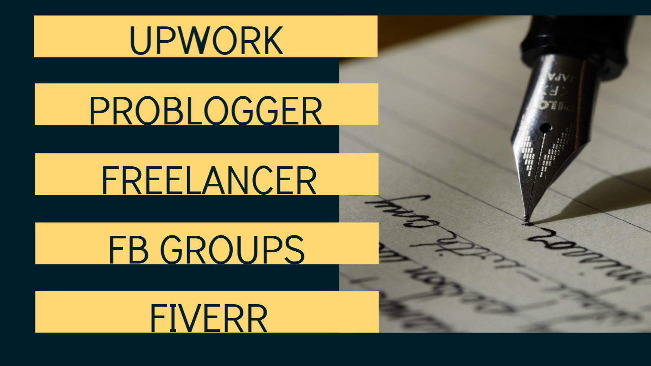

Slide 12


Slide 13
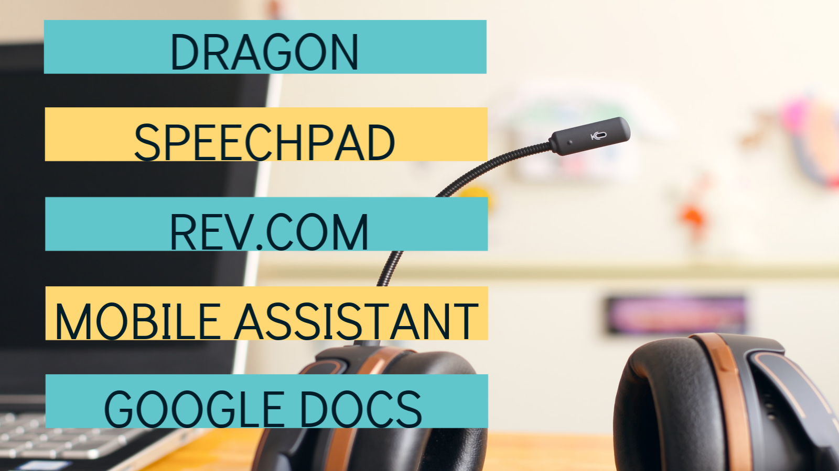

Slide 14

Notes:
User generated content

Slide 15
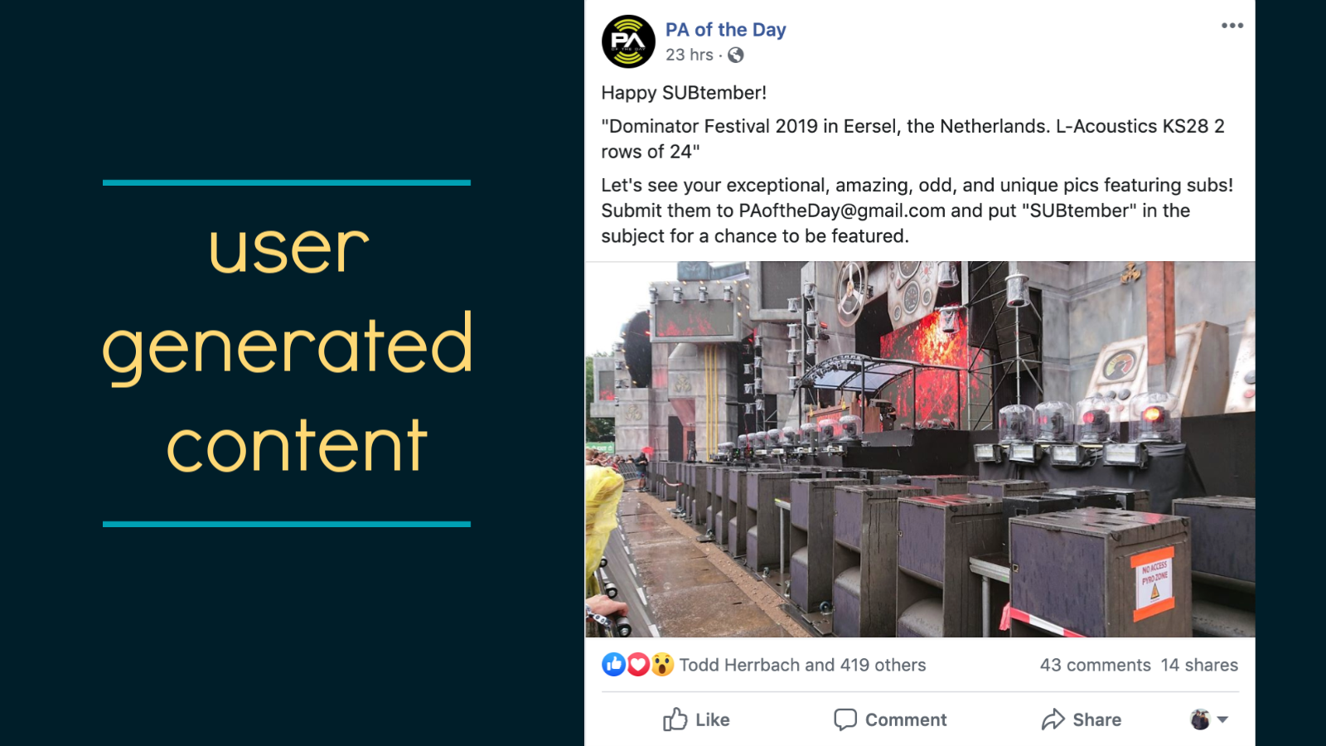

Slide 16

Notes:
Video content

Slide 17

Notes:
Can even film on an iphone

Slide 18

Notes:
podcast

Slide 19


Slide 20


Slide 21
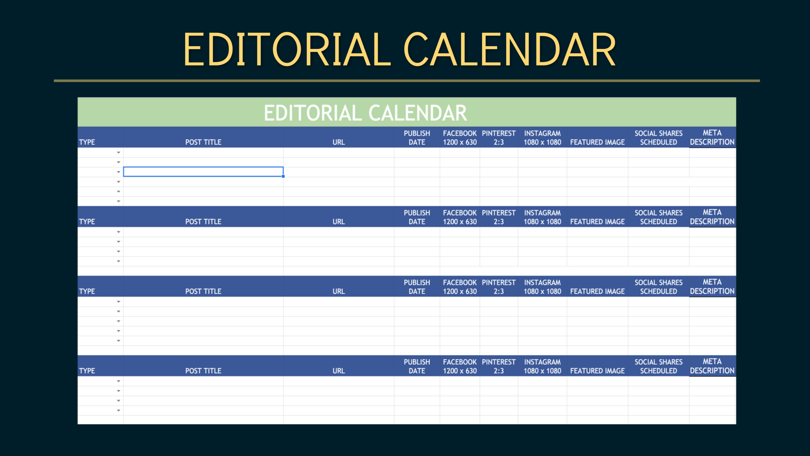

Slide 22
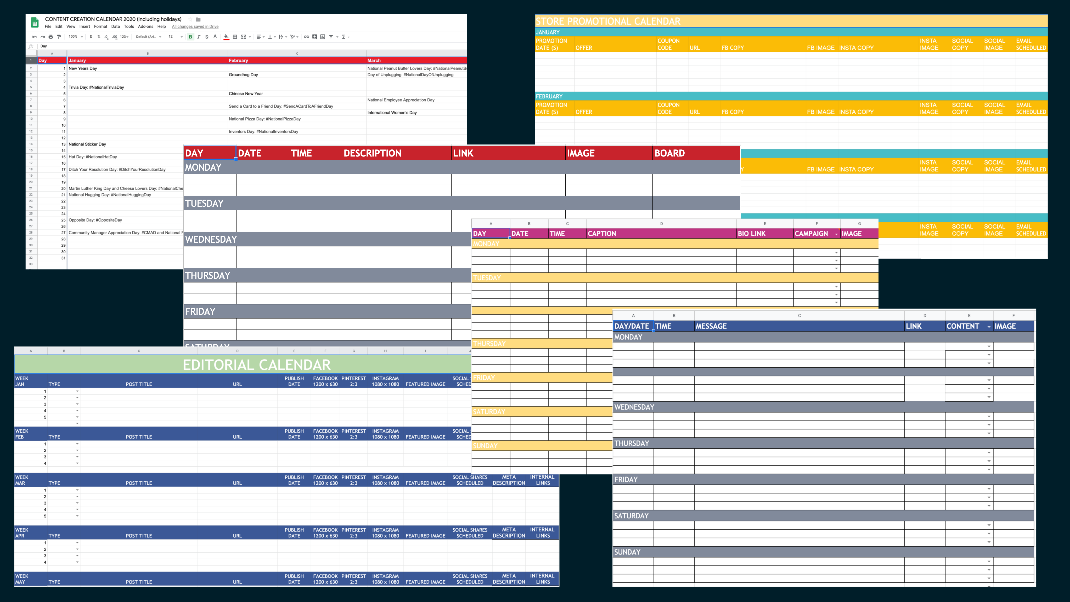

Slide 23
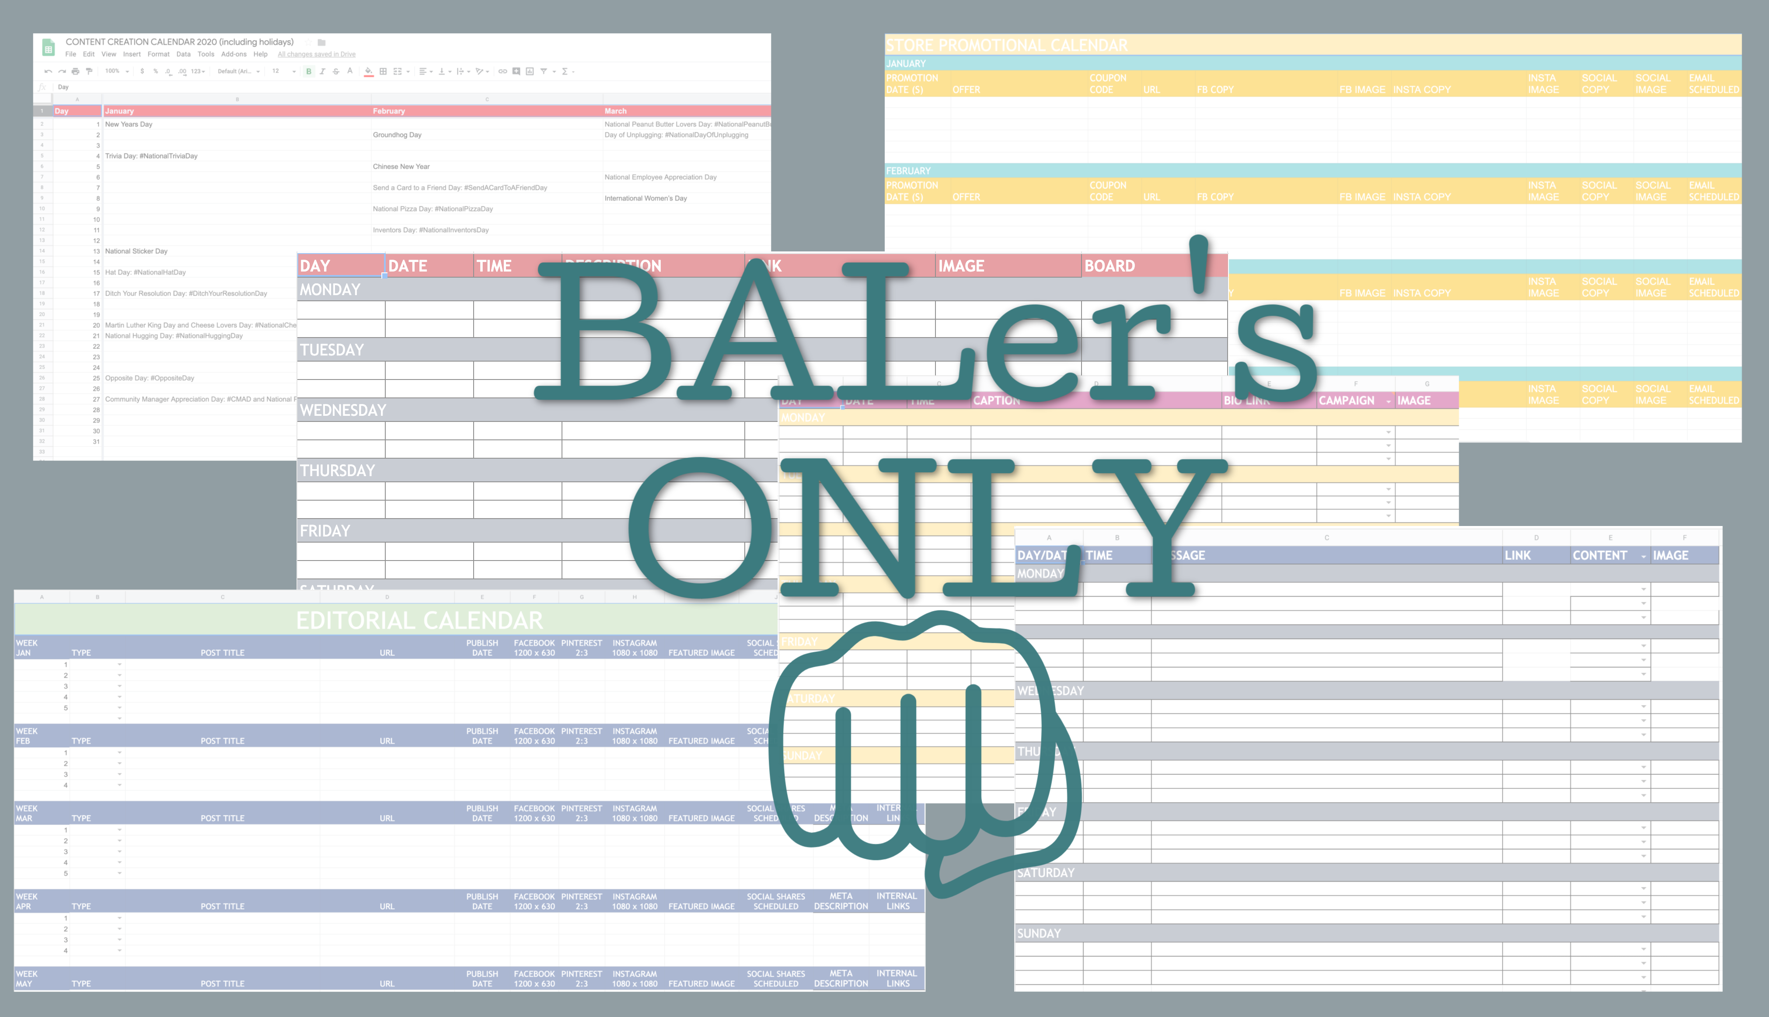

Slide 24


Slide 25


Slide 26
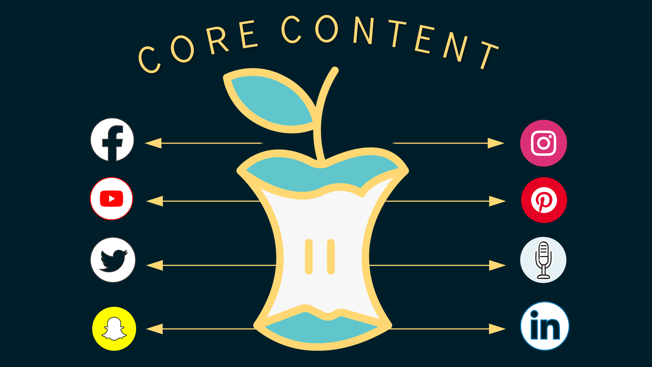

Slide 27






Slide 30


Slide 34
Notes:
Facebook pages: 1-2 per day
Twitter: 3-10 times per day
Instagram: 1-3 times per day
Instagram Stories: 2-5 times per day
Pinterest: 3-20 times per day
LinkedIn: 1-2 times per week

Slide 35

Notes:
If page grows – the rules change

Slide 36
Find your sweet spot!

Slide 37
Notes:
What’s up with this 80/20 rule. What do I share? How much of my own things do I share.

Slide 42
Notes:
80% of your content should be from parallel sources, content that engages followers. Educates followers, promotes followers. (FAQ’s) and 20% is promotional. Pubblx

Slide 43


Slide 49
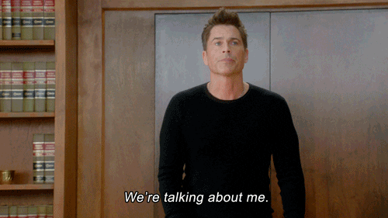
Notes:
Making it all about you

Slide 50
Notes:
Making it all about you

Slide 51

Notes:
A meme or trending hashtag might work well in a tweet, but fall flat on Facebook. Want to share a lookbook or cool new product? Post to Pinterest, but LinkedIn probably won’t do much for you.

Slide 52
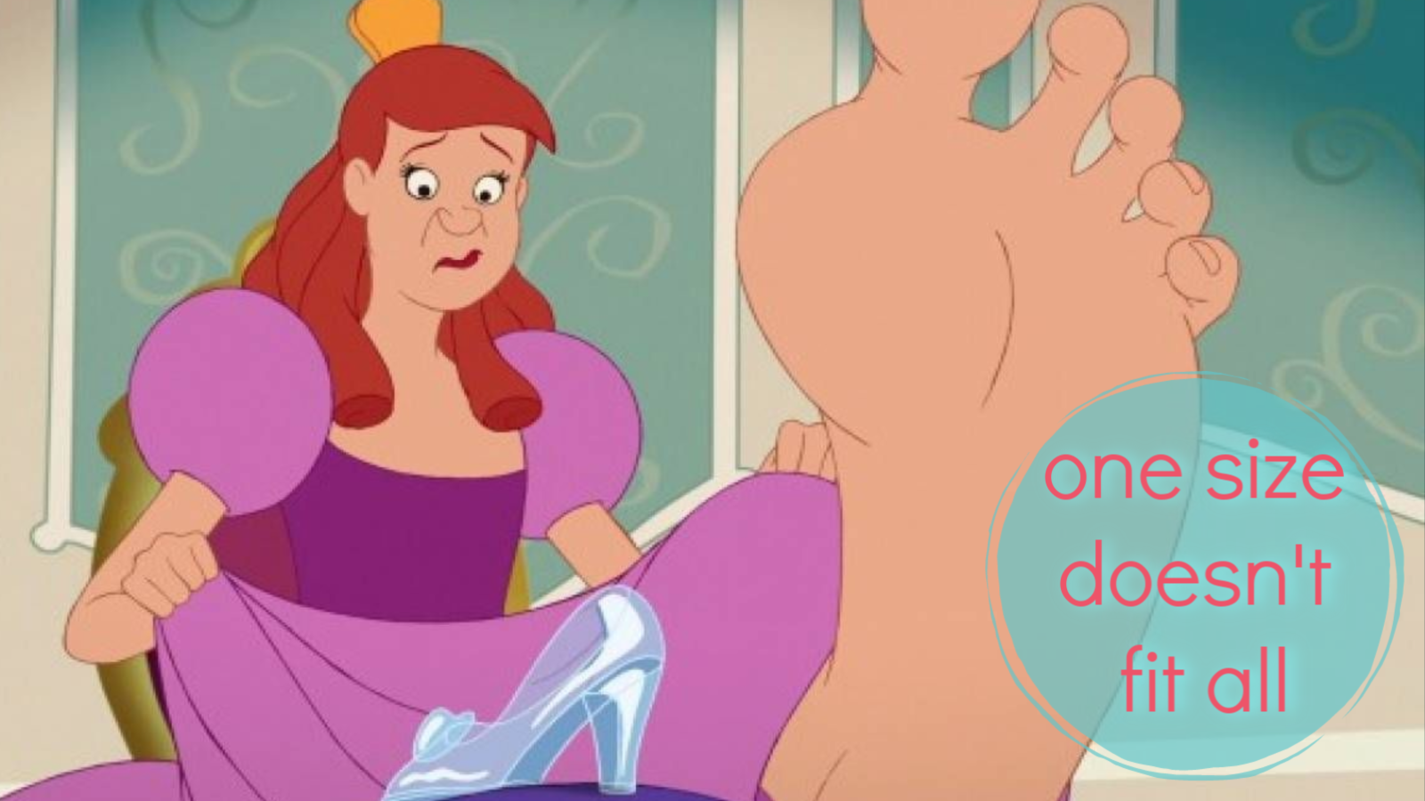

Slide 53

Notes:
Managing too many accounts. You should own every platform- but you can’t do every platform well unless you have a team. Find which platforms work best with your audience and focus on them.

Slide 54
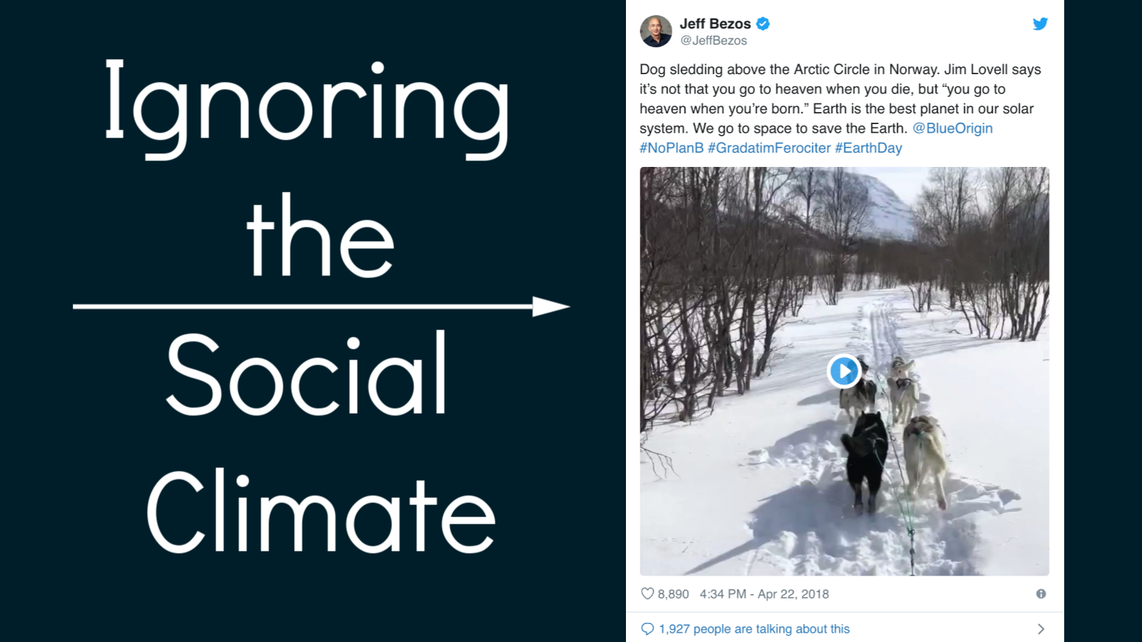

Slide 55
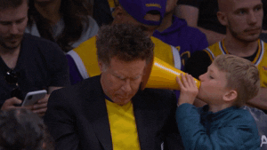
Notes:
Not engaging with your audience

Slide 56

Notes:
Ghosting your audience. Posting in bursts.

Slide 57


Slide 58


Slide 59


Slide 60
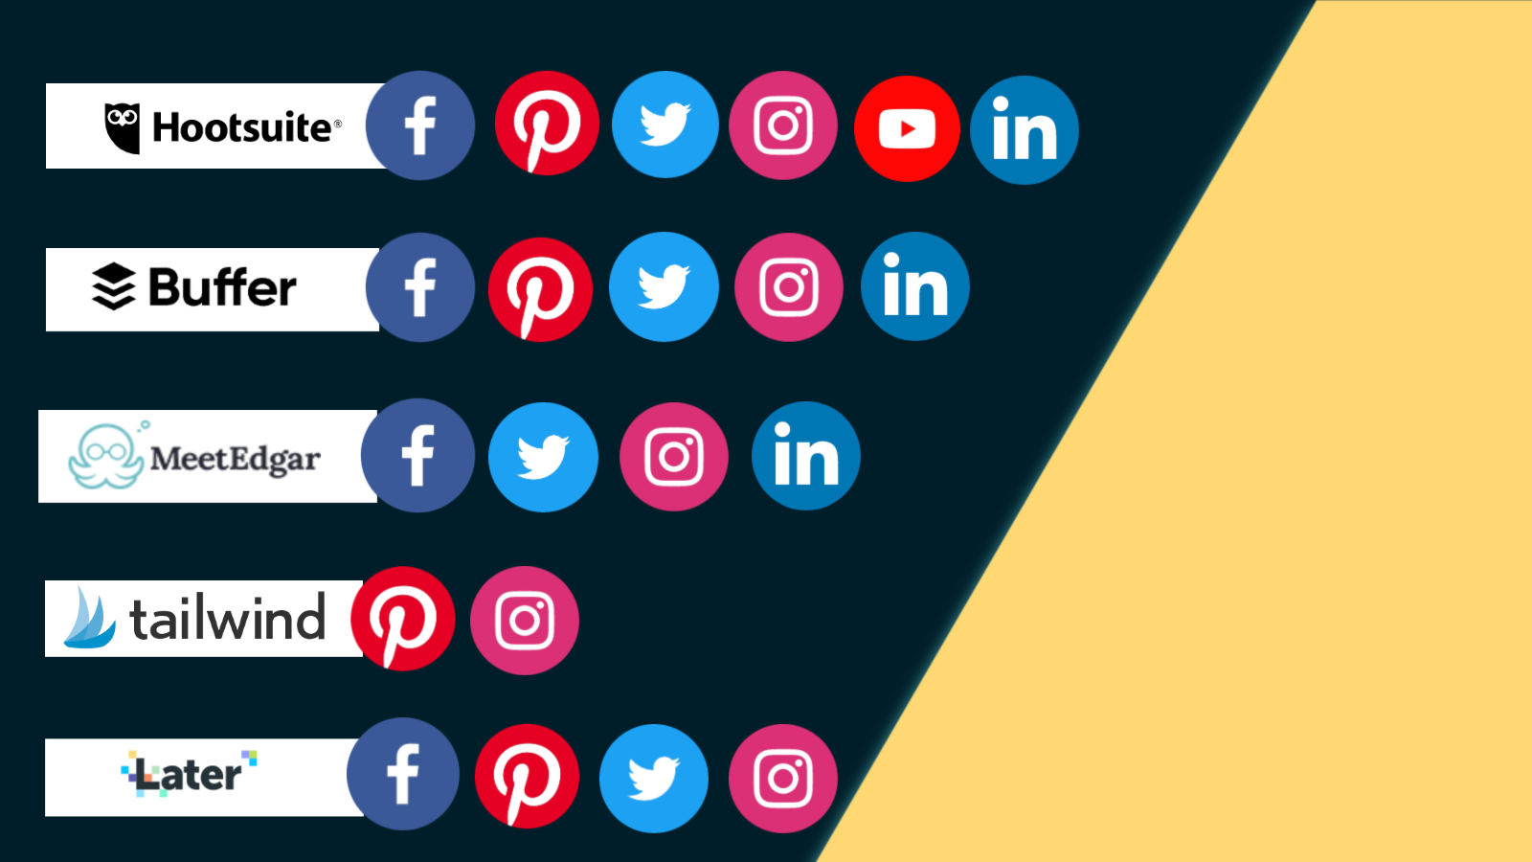

Slide 61
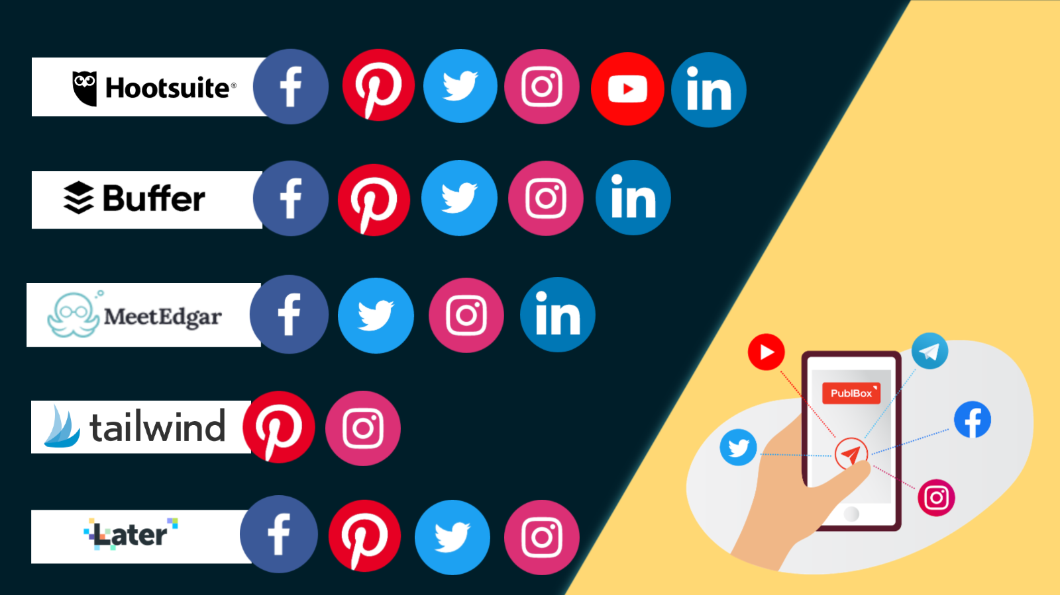

Slide 64
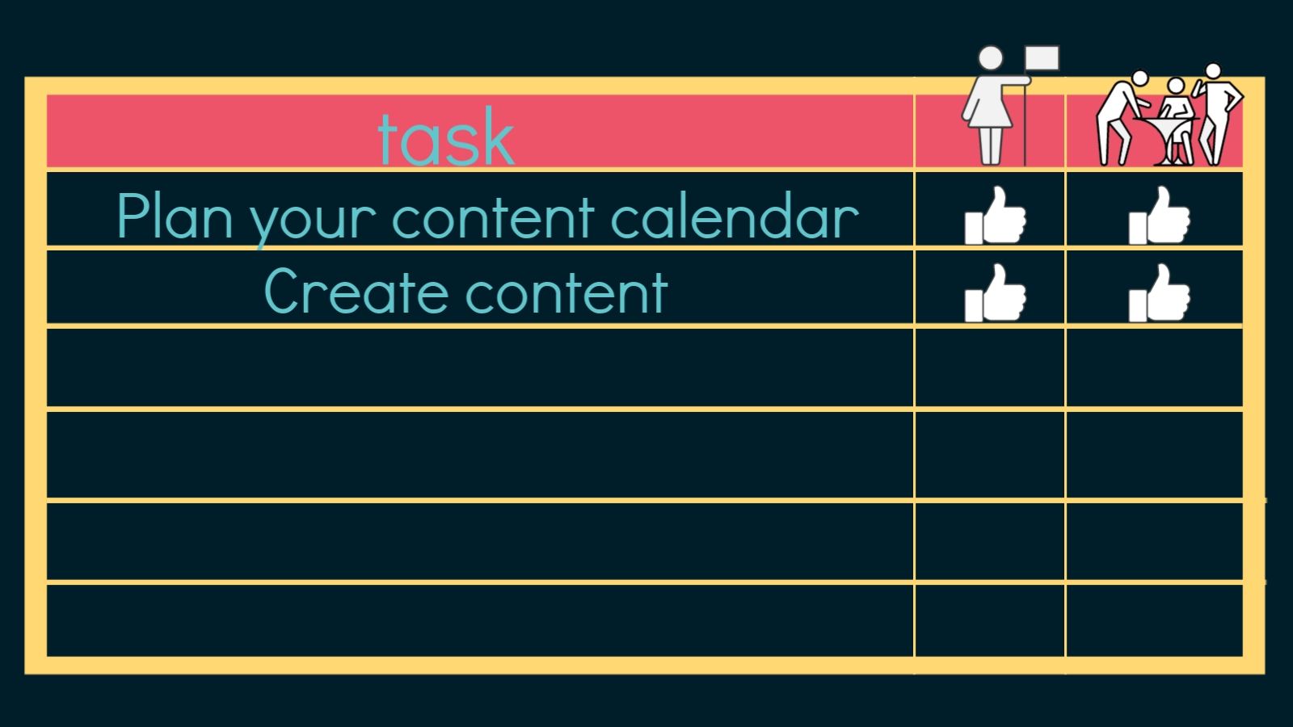

Slide 65
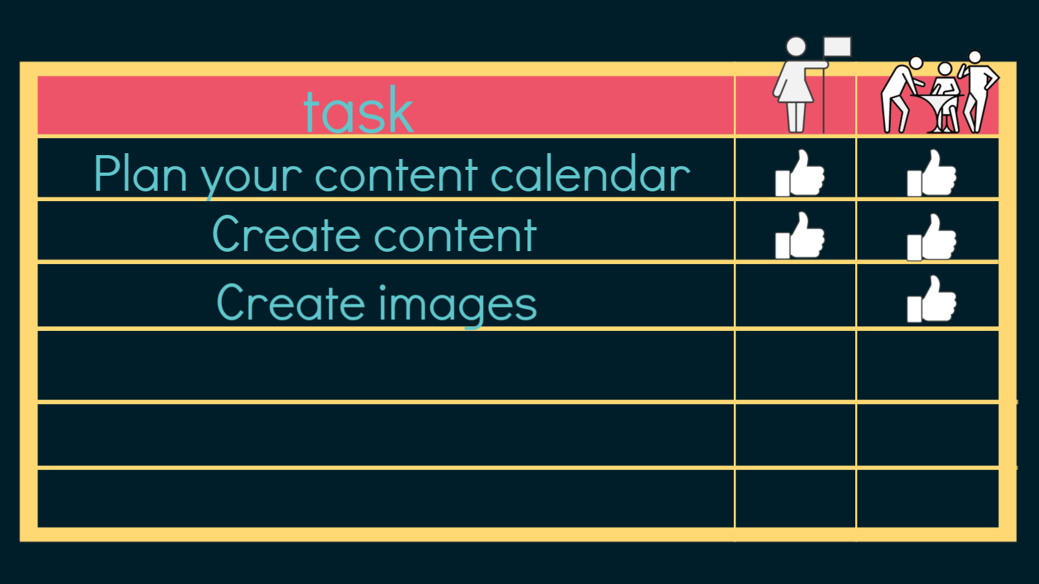

Slide 66
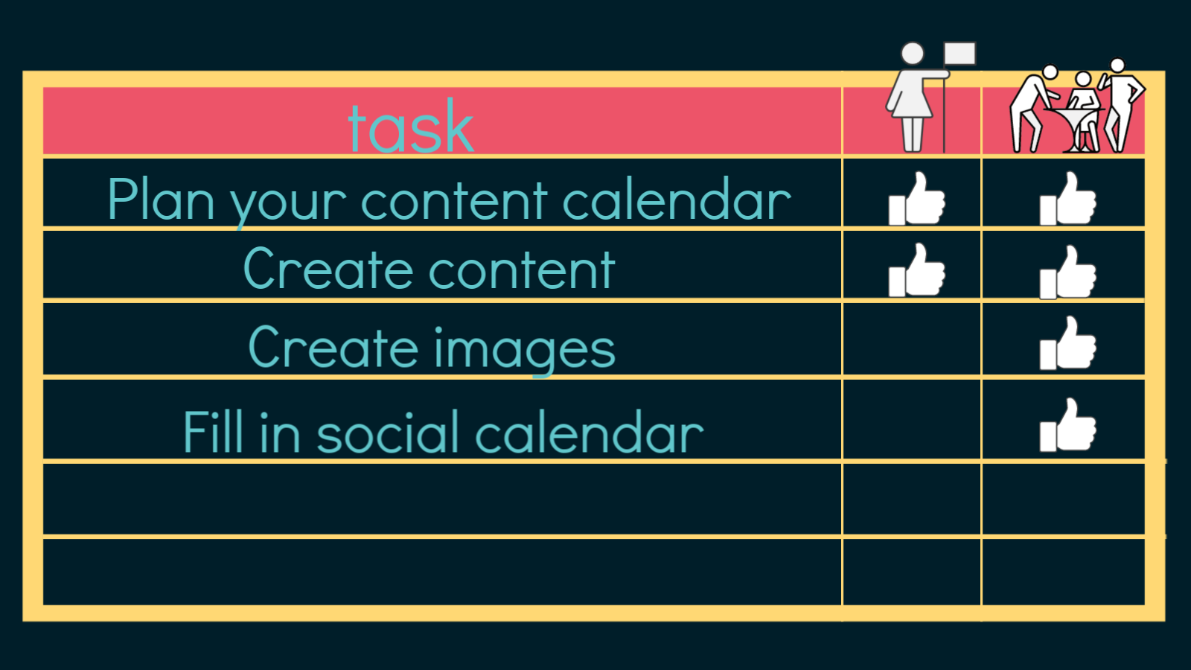

Slide 68
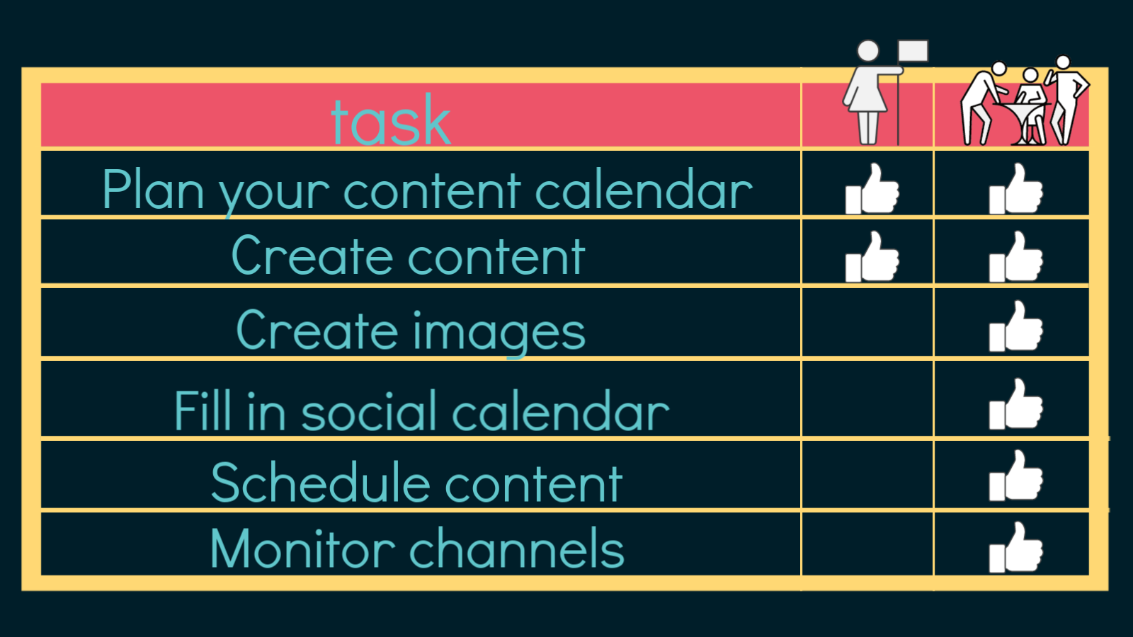

Slide 69
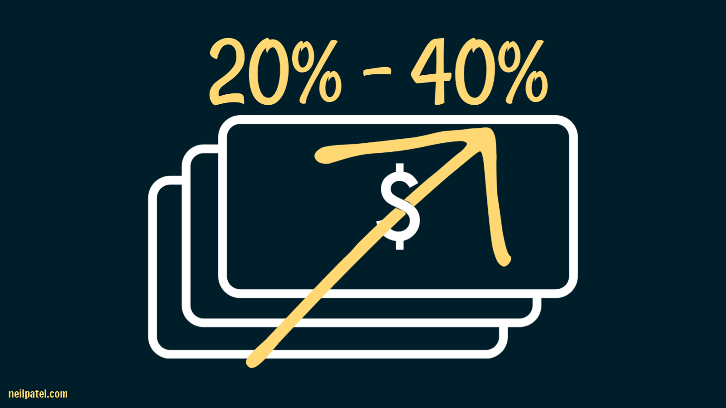
Notes:
customers spend 20-40% more with companies that they have social media engagement with.

Slide 70


Slide 71
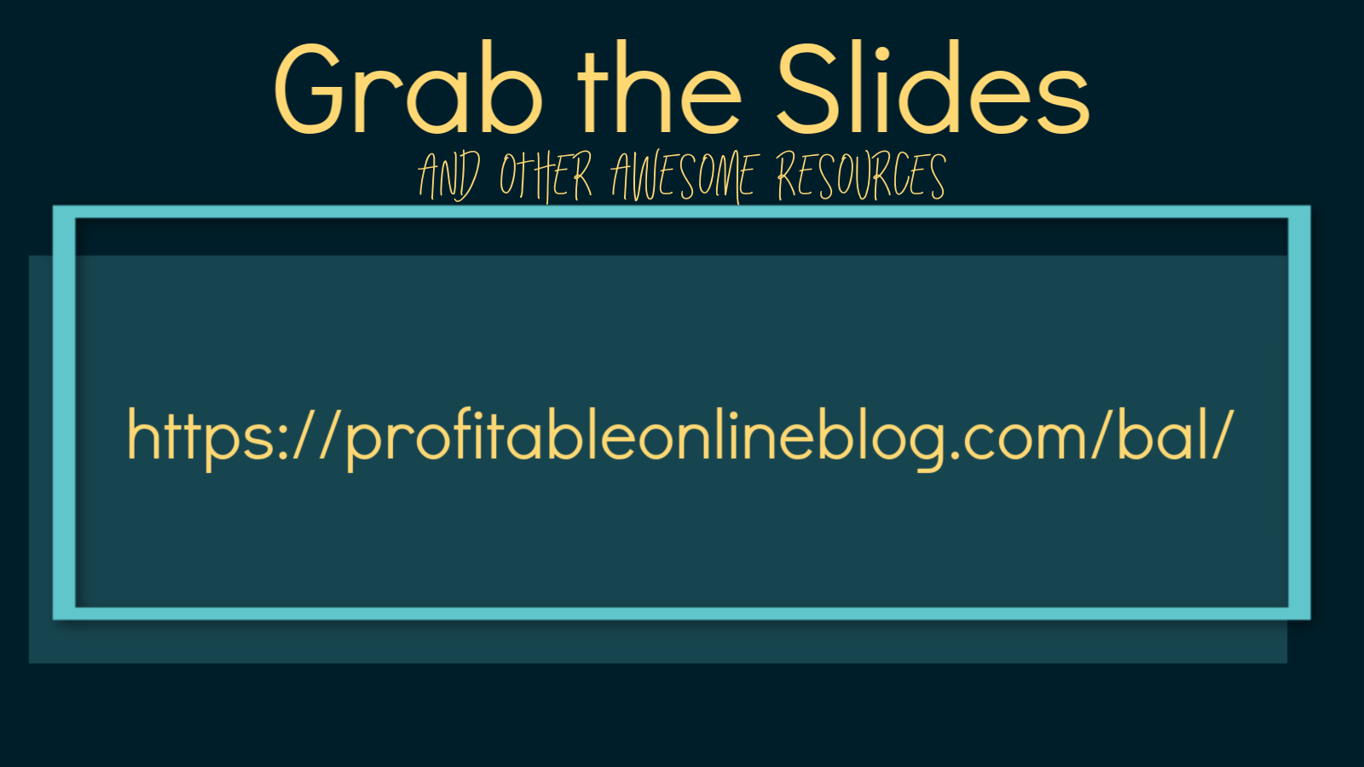
Grab this presentation

